Slide 1





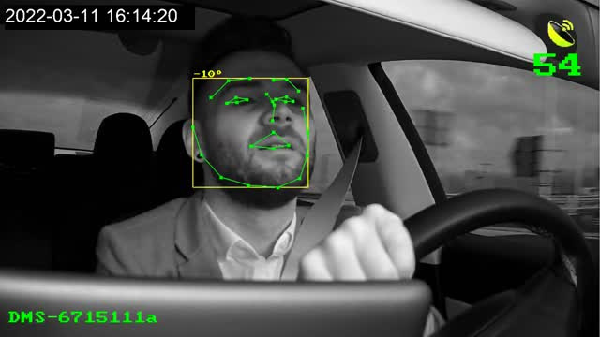
ESH
DRIVER PROTECTION SYSTEM
Date: Dec 4, 2024
Presenter: Kareem Mansour

Slide 2





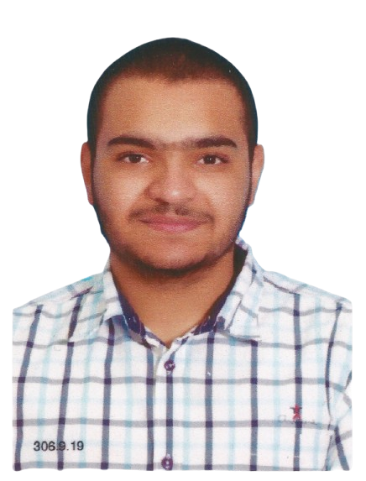



OUR TEAM
Kareem Mansour
Mohamed Gamal
Youssef Mohamed
Mechatronics Engineer
Mechatronics Engineer
Mechatronics Engineer
Developer and Responsible for working with AI models
Responsible for statistics, research and customer relations
Mechanical Designer and Product Design Officer

Slide 3



WHO IS MY CUSTOMER
01
Individuals
especially those who suffer from long driving hours, diabetes and epilepsy
03
Insurance companies
to reduce risks and find out the cause of the accident
Transport and shipping companies
to ensure the safety of truck drivers and to know the cause of the accident
Governments and traffic authorities
(to implement it as part of safety policies).
02
04

Slide 4
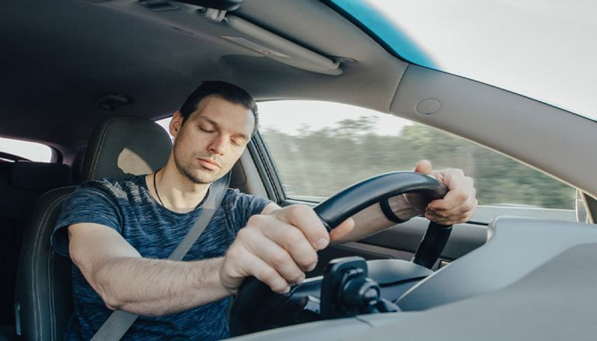
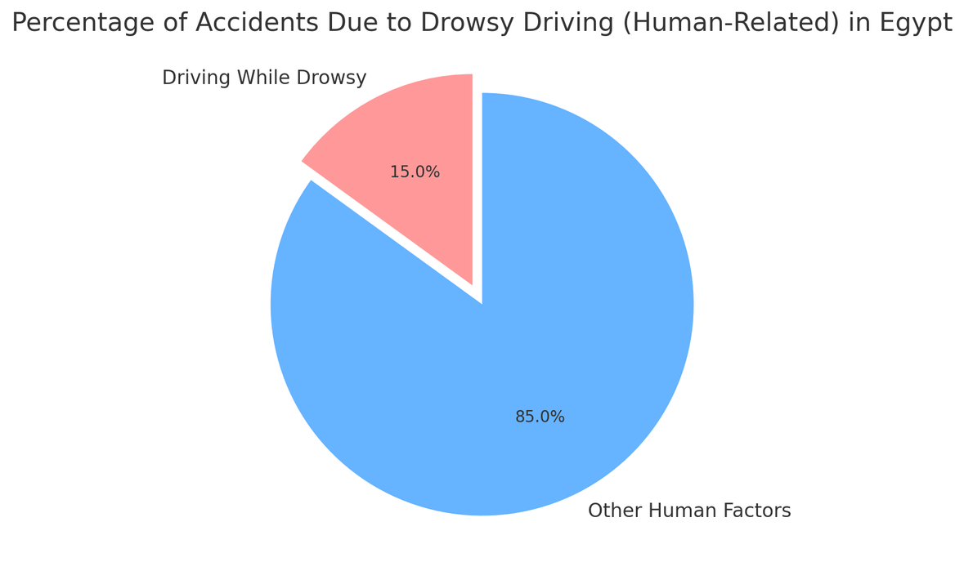

THE PROBLEM
Accidents due to sleep while driving

Slide 5


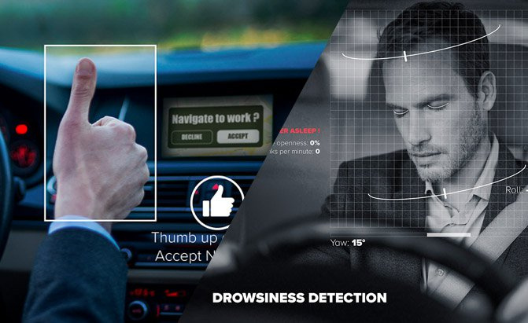



SOLUTION
Face Monitoring: Detects prolonged eye closure and alerts the driver.
Mobile App Integration: Activates monitoring while driving.
Car Controller Integration: Automatically stops the car in case of an issue.
Health Monitoring: Detects symptoms of panic attack

Slide 6

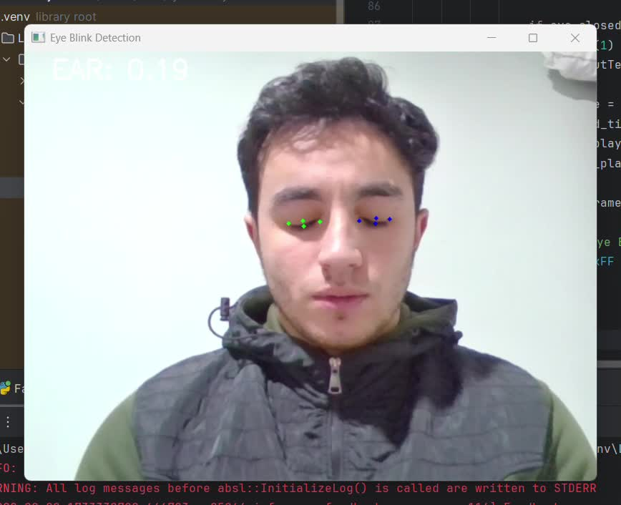

Slide 7
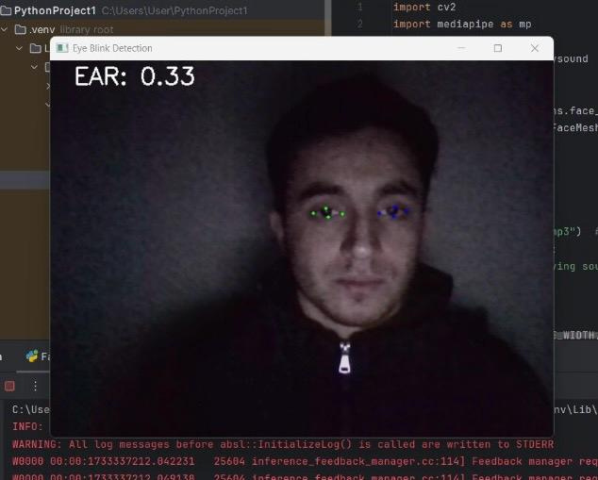

Slide 8


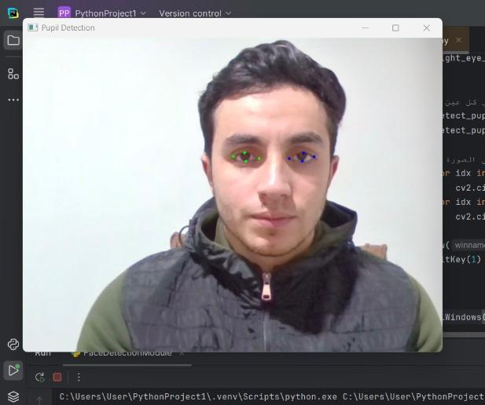
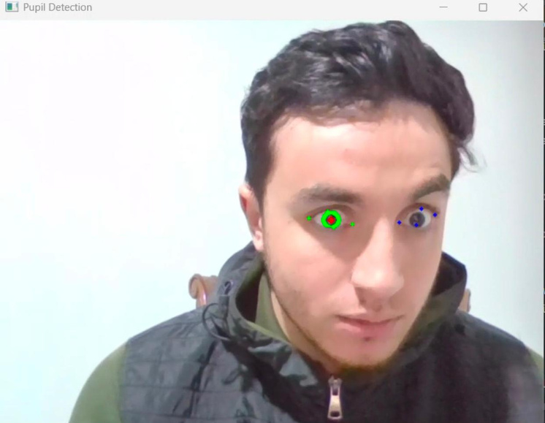
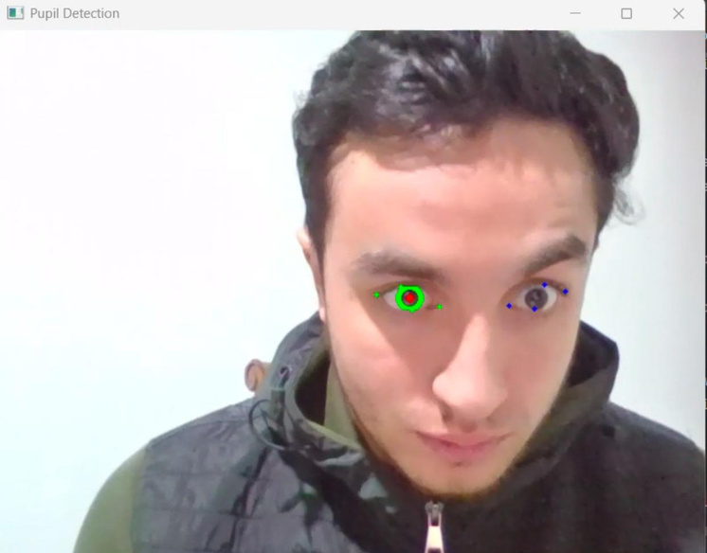


PANIC ATTACKS AND STROKE

Slide 9
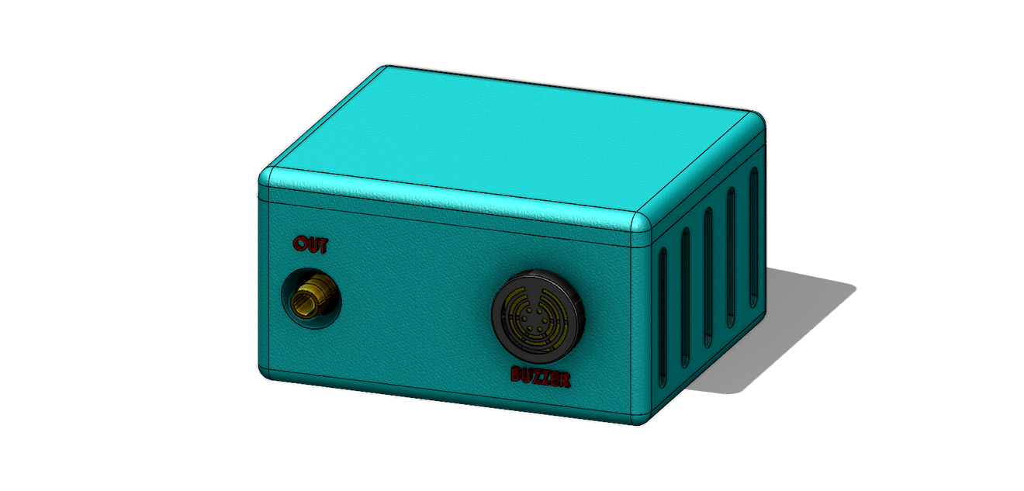
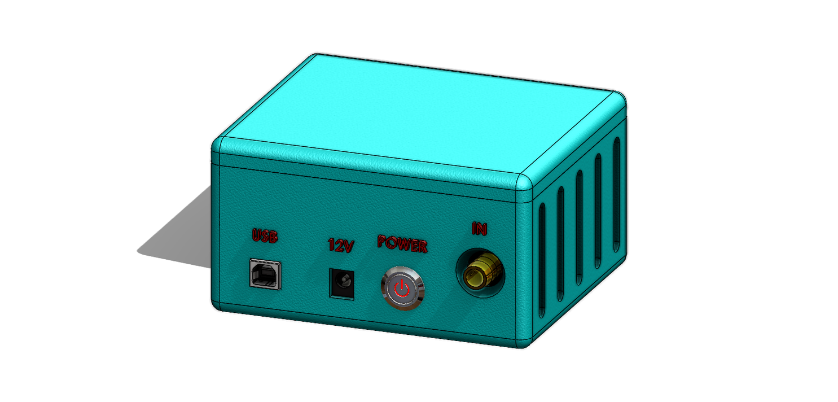

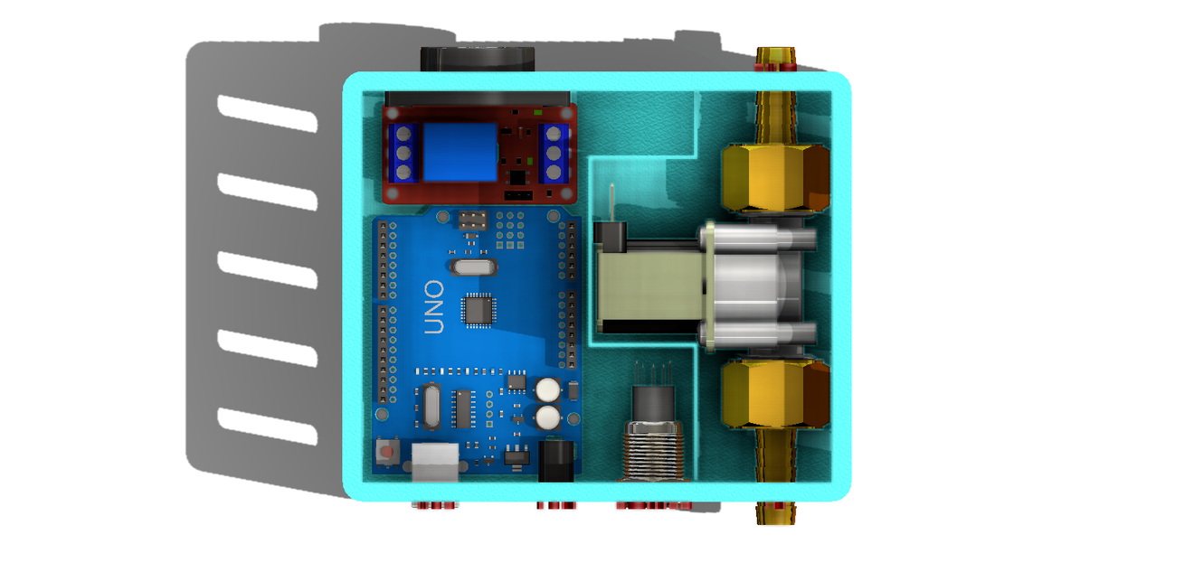
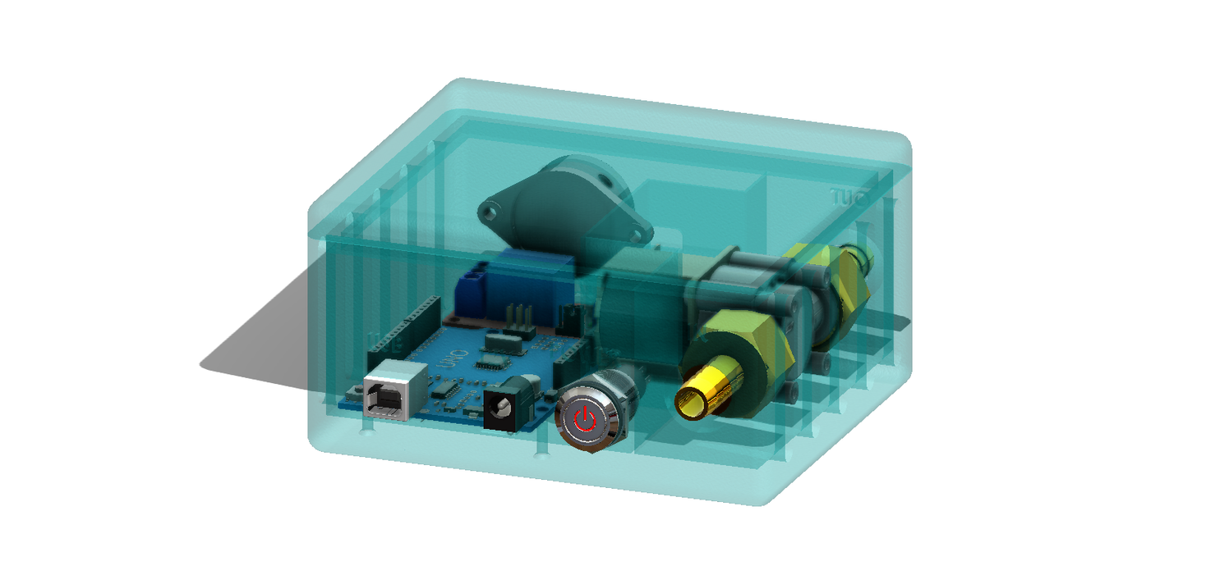
PROTOTYPE

Slide 10




VALUE PROPOSITION
Save more lives, save more money
Transport and shipping companies
Individuals
Training programs
• Reduce accidents resulting from sleep driving or medical emergencies.
• Improving the reputation of transportation companies and automobile companies by adopting advanced security technologies.
Insurance companies
to familiarize customers with how to use the system.
• Reducing insurance costs resulting from accidents.

Slide 11



REVENUE STREAMS
Sell ​​the product
Sell ​​the system as a standalone product.
services by us
There are more security factors that we can offer in the company for more money.
services to companies
Selling Data
Providing customized services to transportation companies.
• Selling data anonymously to insurance companies for risk analysis.

Slide 12
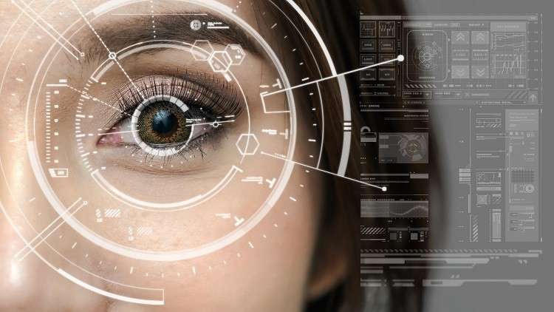

ANY QUESTIONS ?
Ready to answer questions

